Slide 2
Accelerating Machine Learning Predictions with NVIDIA TensorRT and Apache Beam
Shubham Krishna ML Engineer, ML6

Slide 3

Who is ML6?
Machine Learning services company.
We help our clients build
machine learning applications using technologies such as Apache Beam.

Slide 4
Agenda
Motivation
Solution
Beam RunInference: Seamless integration of ML in a Beam pipeline for semantic enrichment
Nvidia TensorRT: Accelerated + Optimized ML Inference
Example
Notes:
Why?, What’s the motivation behind? What’s the problem here?
Solution to the problem
Example describing the solution to have a better picture

Slide 5
Motivation
Semantic Enrichment: ML models provide semantic information.
Increasing scale and hardware requirements of ML models.
Notes:
ML models are very good at providing semantic information about the data you are dealing with
This helps in understanding customer feedback, social media sentiment, or user opinions, enriching the data with sentiment scores or labels.
ML models are getting bigger, so you want a solution that is also fast enough

Slide 6
Semantic Enrichment of Data
Categorise: Add specific label
Summarize
Sentiment Analysis
Translate
Extract important keywords
Image Annotation
Image Captioning
Speech Recognition
…..
Notes:
Explain less here,

Slide 7
Problem
Solution
Seamlessly integrate ML models in a Beam pipeline for semantic enrichment of data.
RunInference API = Inference with ML model in batch and streaming pipelines, without needing lots of boilerplate code.
Increasing scale (longer inference times) and hardware requirements of models.
Nvidia TensorRT = optimized + accelerated ML inference

Slide 8
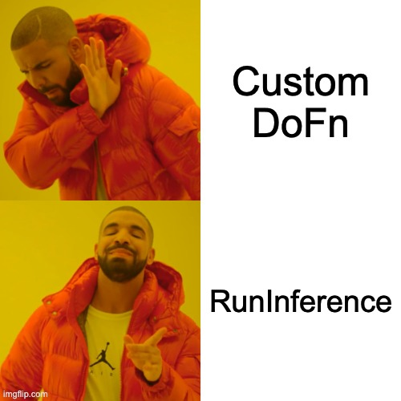
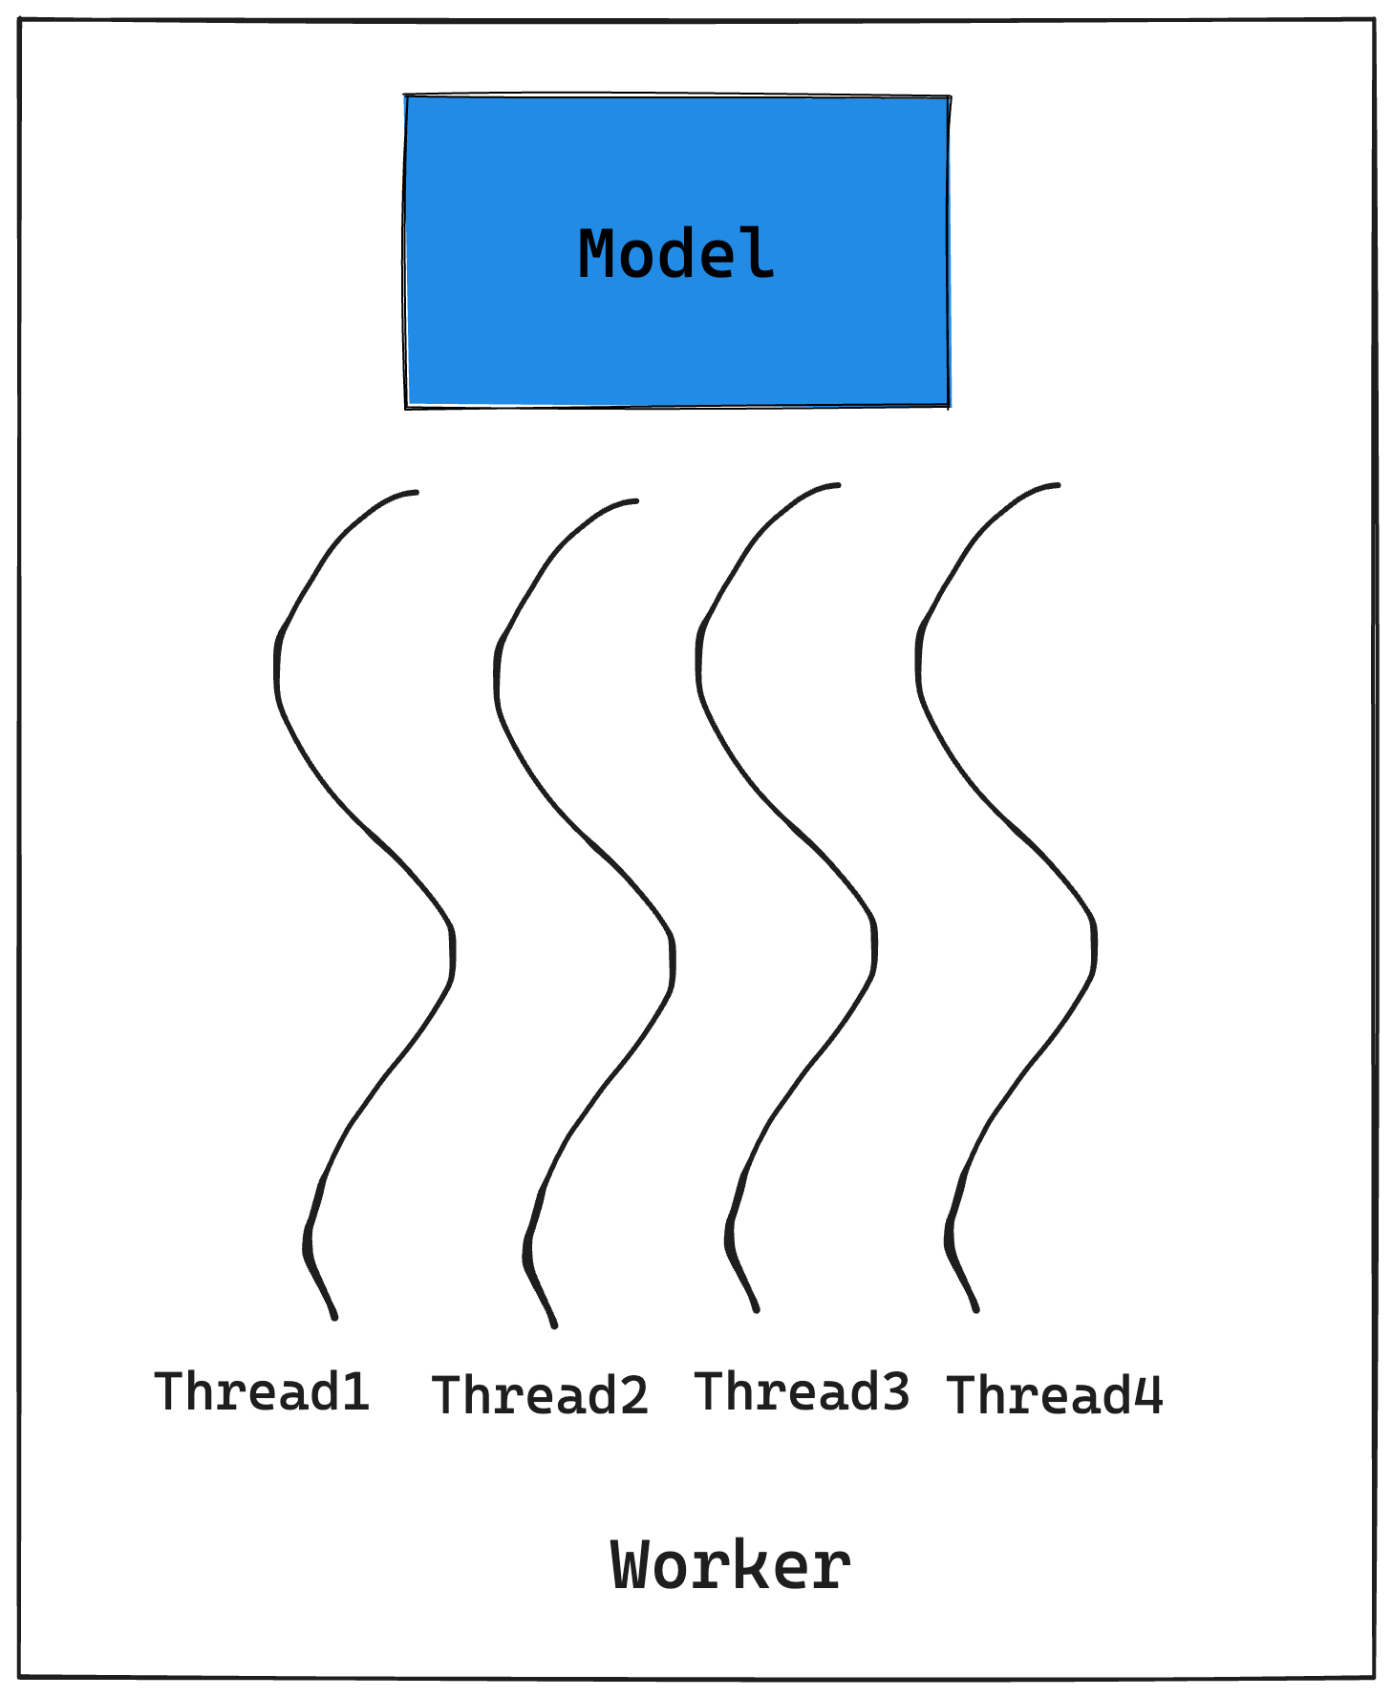
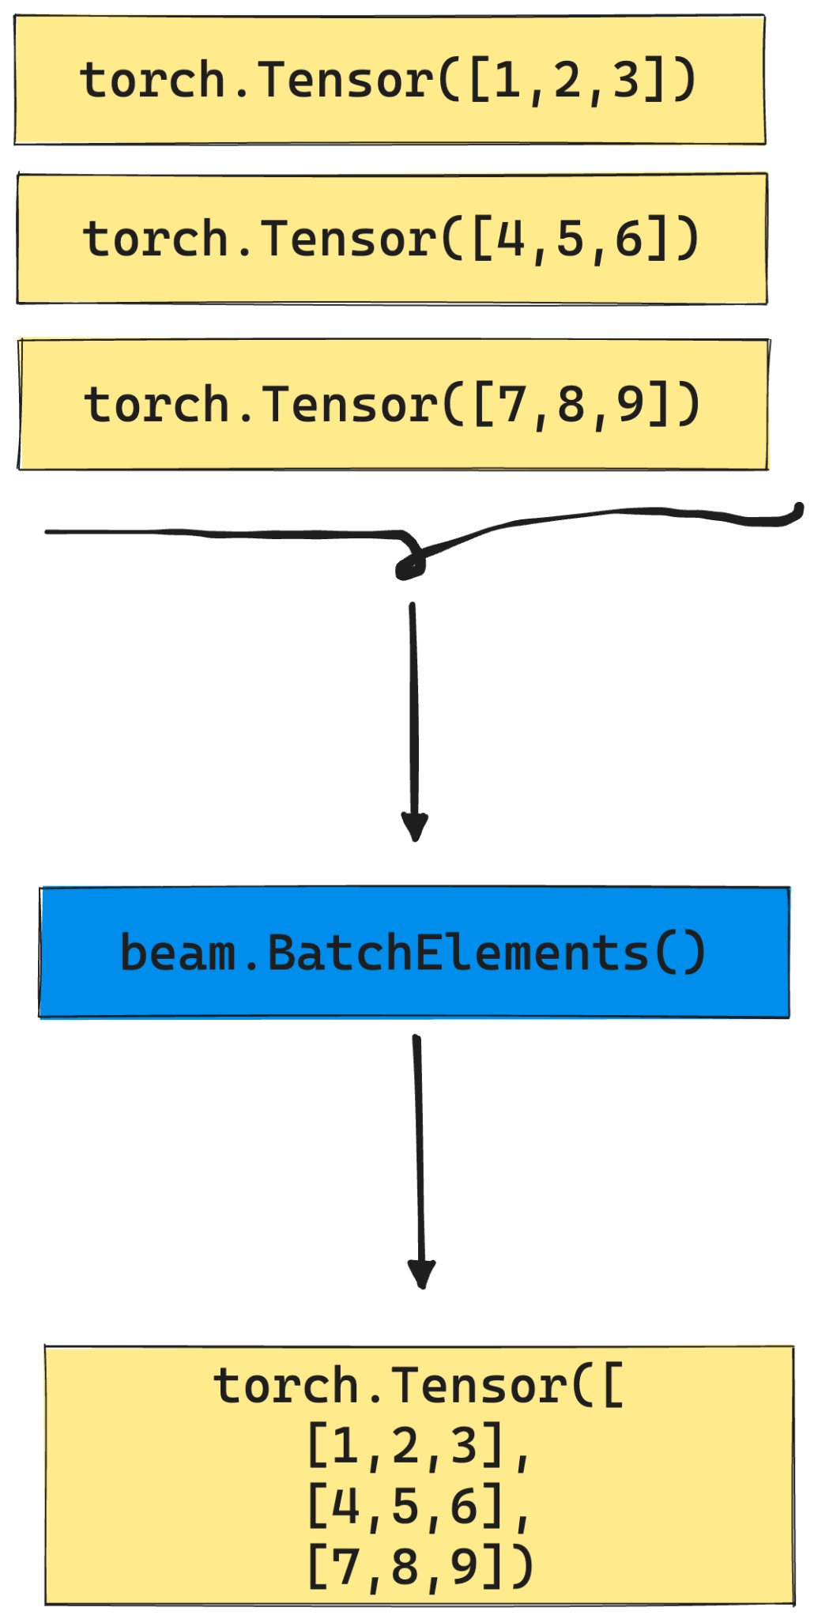
RunInference >> Custom DoFn
Seamlessly integrate ML model in a Beam pipeline for semantic enrichment of data.
Notes:
write lots of boilerplate code,
Do fn: load model, based on framework, Handle yourself batching, shared class of model,
Error handling, metrics like mean batch latency
Do fn: good for prototyping

Slide 9




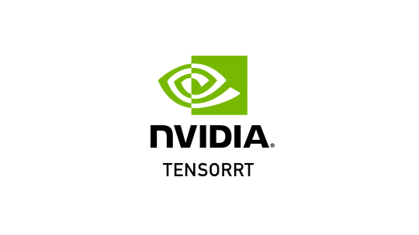

RunInference supports popular ML frameworks

Slide 10
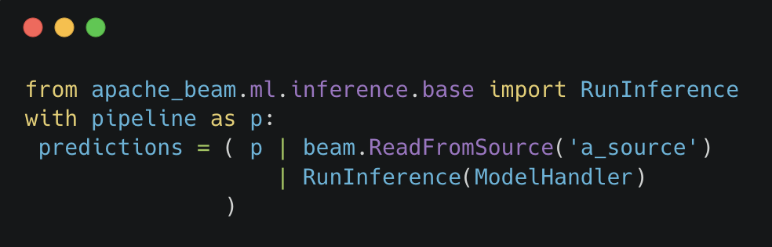
How to use RunInference?
Notes:
Just one import statement, and pass the model handler to the RunInference

Slide 11
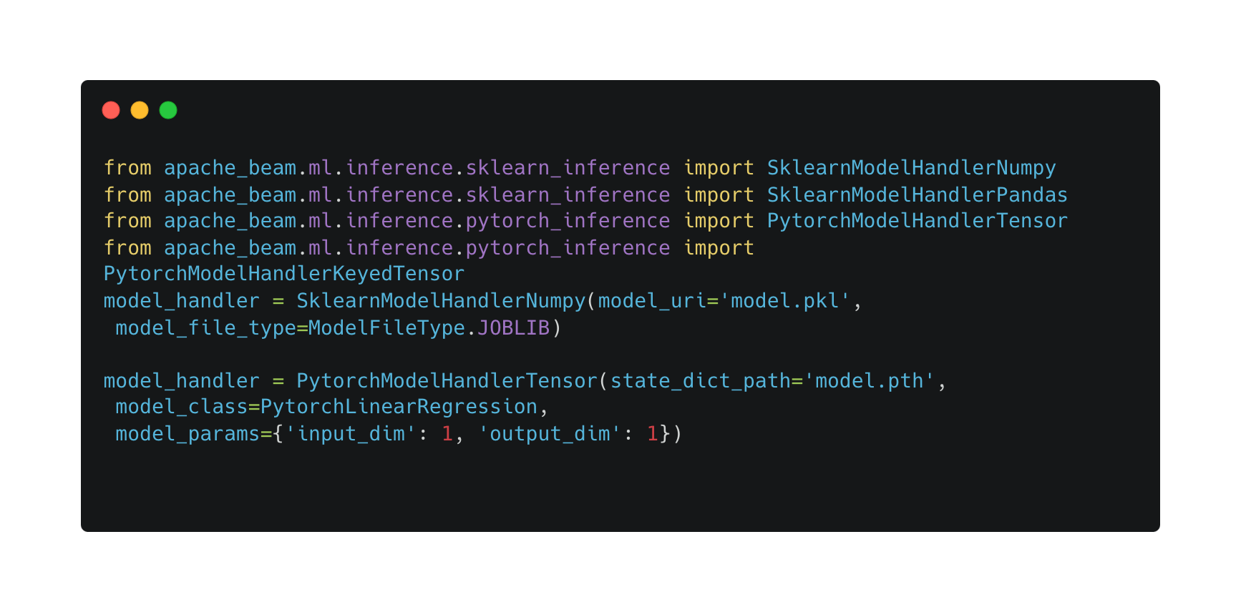
ModelHandlers
Notes:
ModelHandler is a configuration that informs RunInference about the model details and that provides type information for the output.

Slide 12
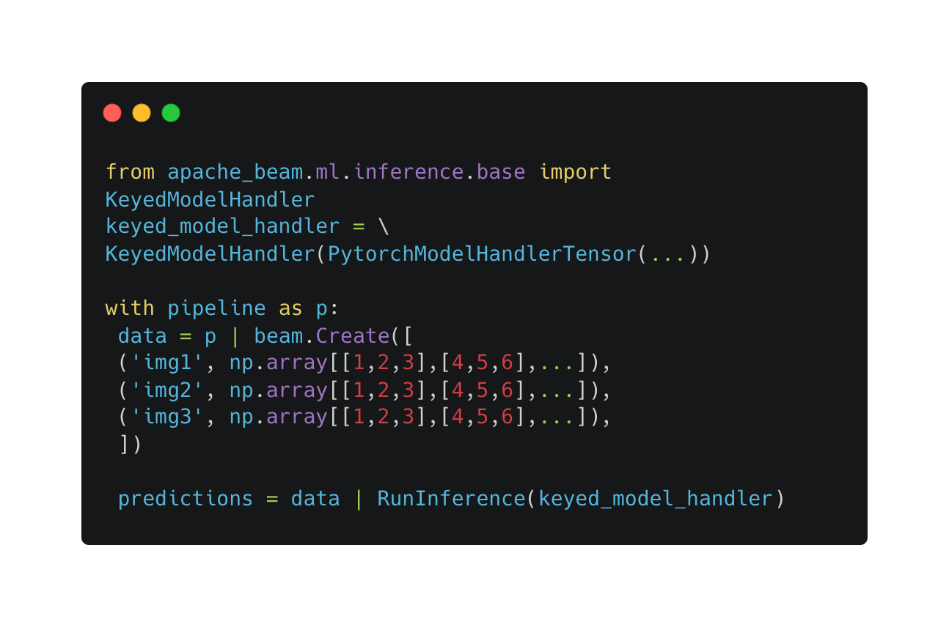
KeyedModelHandler
Notes:
To keep a reference to the image that the inference is associated with., To aggregate transforms of different inputs., To run postprocessing steps correctly.

Slide 13
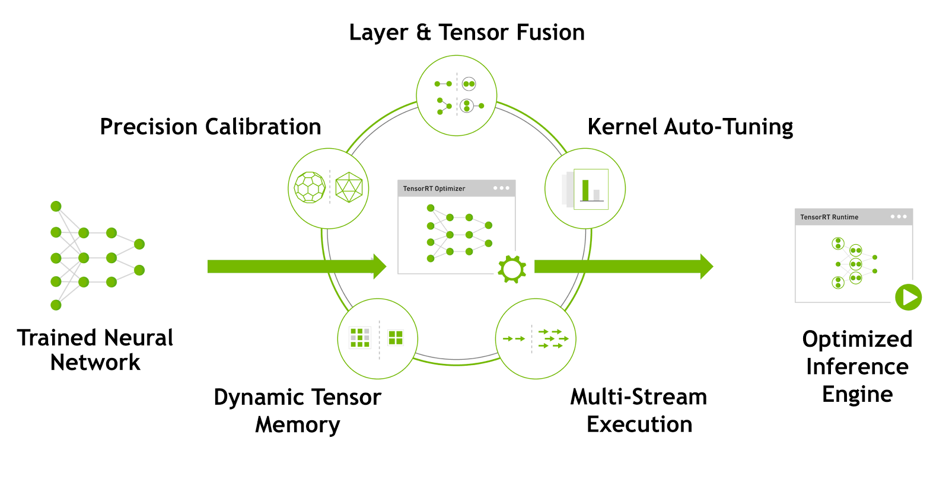
Nvidia TensorRT
Flexible: An SDK designed to work with ONNX, TensorFlow, PyTorch, and others.
Optimizes a neural network for faster inference on NVIDIA GPUs, while preserving model accuracy.

Slide 14

Simplified and Accelerated Inference Pipelines
RunInference API

Slide 15
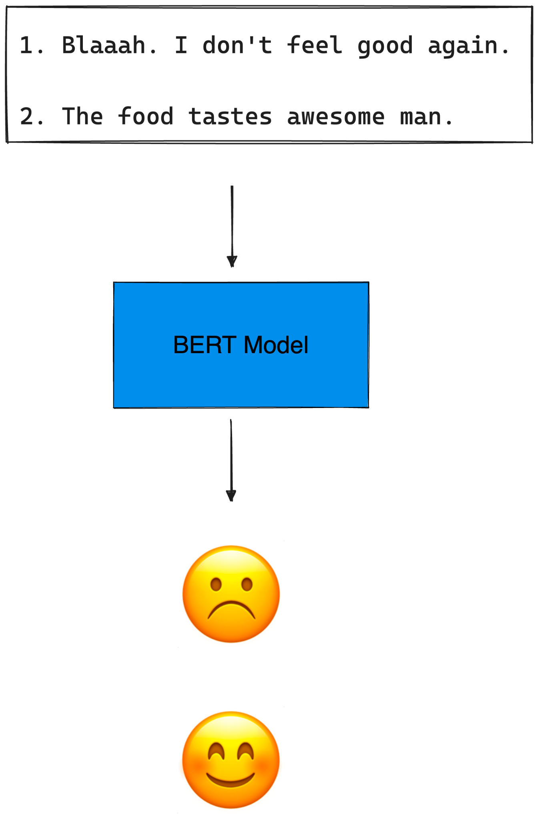
Example
Using a trained BERT-based (Transformer) text classification model for sentiment analysis in a Beam pipeline.
Notes:
Let’s deep dive into an example where we use both RunInference and TensorRT in a beam pipeline
A Sentiment analysis example, where we

Slide 16
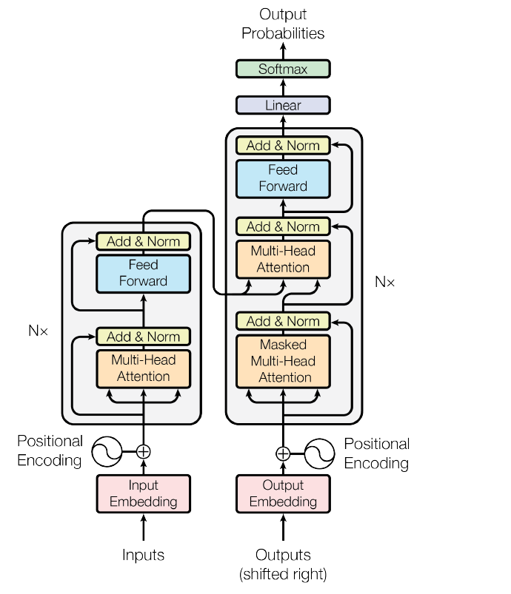
BERT
A state-of-the-art (NLP) language model, Google.
Can be fine-tuned for NLP tasks: text classification, named entity recognition, question answering, etc.
textattack/bert-base-uncased-SST-2 finetuned on SST-2 for sentiment analysis.

Slide 17
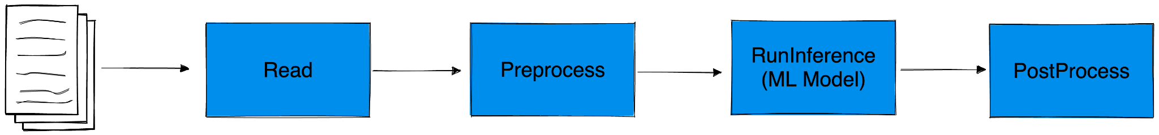
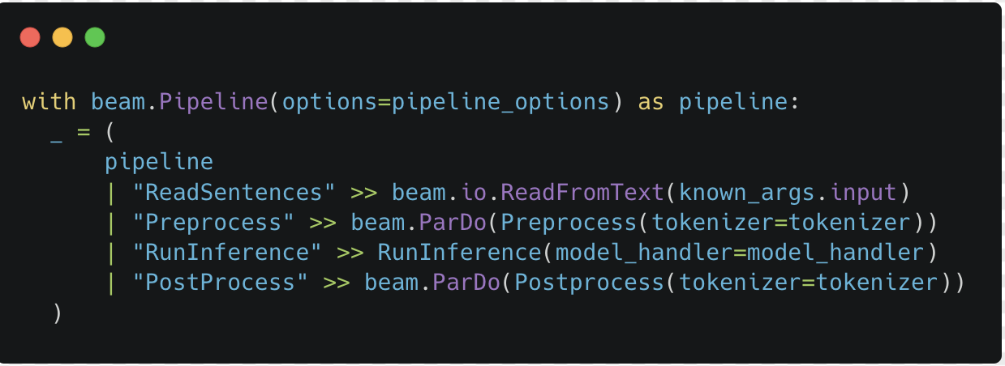
ML Inference Pipeline in Beam as a DAG
[File]
Tutorial Link: Apache Beam Documentation
Notes:
The end to end pipeline looks like this as a DAG
And the code looks also quite simple using RunInference,
Each ML model usually have a Prepocess, Inference, PostProcess steps
In the next slides, I will go one by one at each of the steps and explain them

Slide 18
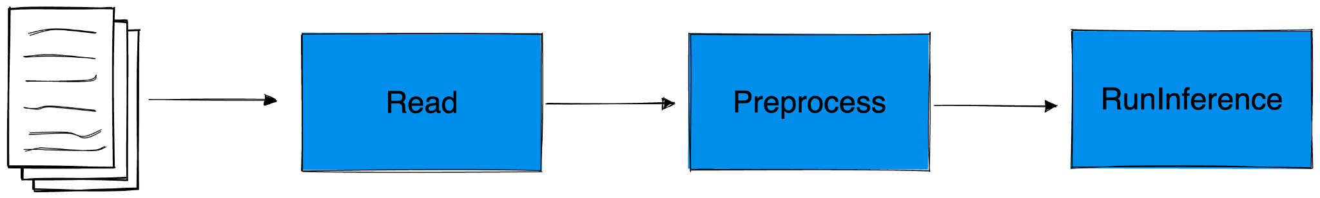
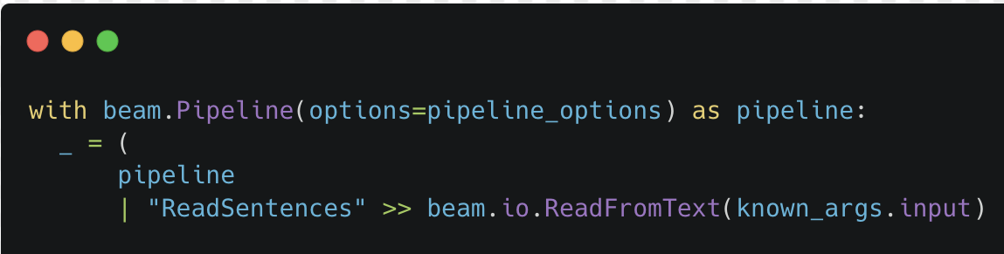
Read Texts from File
[File]
Blaaah. I don't feel good again.
The food tastes awesome man.
.
.
Notes:
Skip reading texts

Slide 19
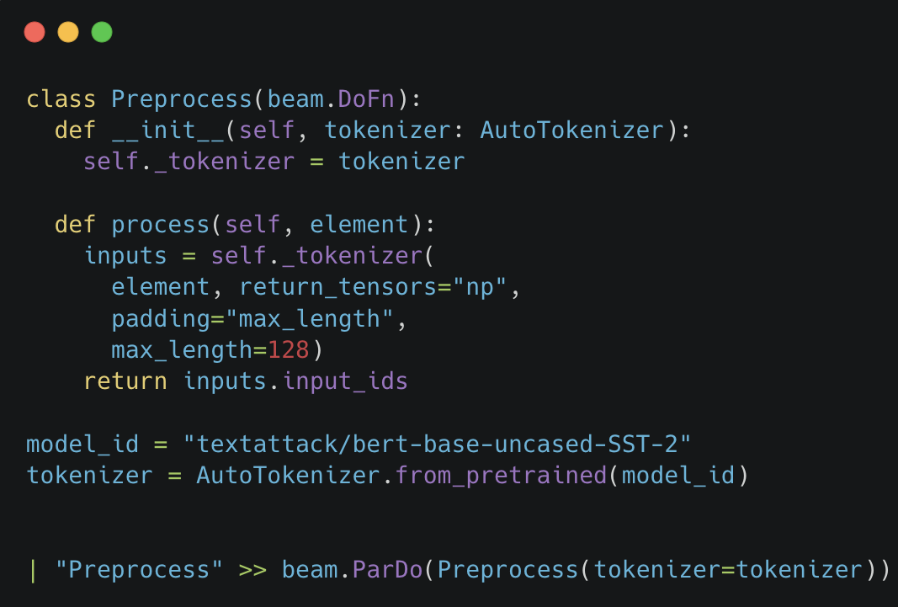
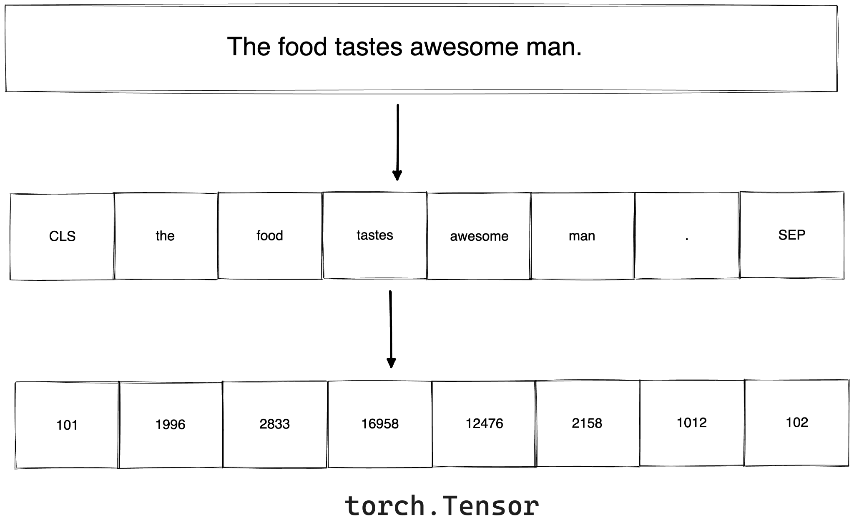

Preprocess(Tokenization)
[File]
Notes:
Skip the explanation for the tokenization.

Slide 20
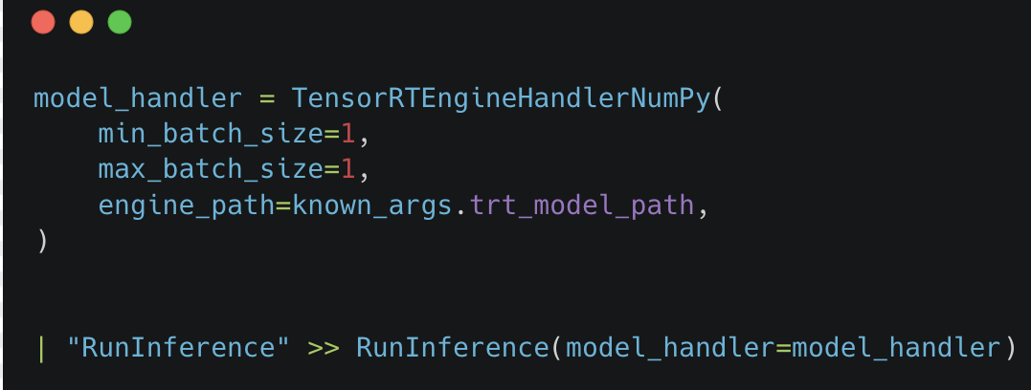
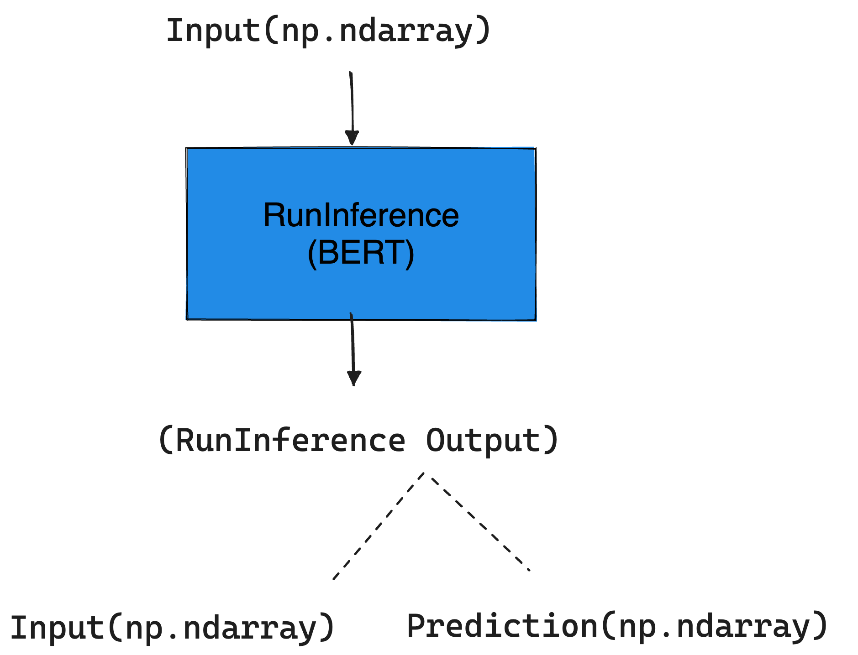
TensorRT and RunInference
[File]
Notes:
RunInference requires model_handler, Batch-size, Engine path
Inference_fn if normal forward function
It takes the preprocessed input from the Preprocess

Slide 21
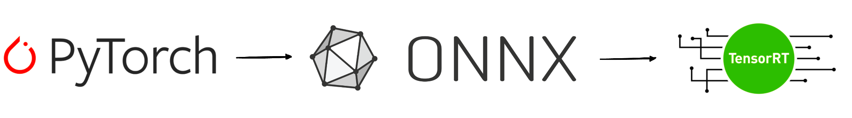
Convert PyTorch model to a TensorRT Engine File
A common way to convert PyTorch model to TensorRT
Notes:
Assuming you have a pytorch model one of the common way is to first convert to ONNX(a serializable format) and then to TensorRT

Slide 22
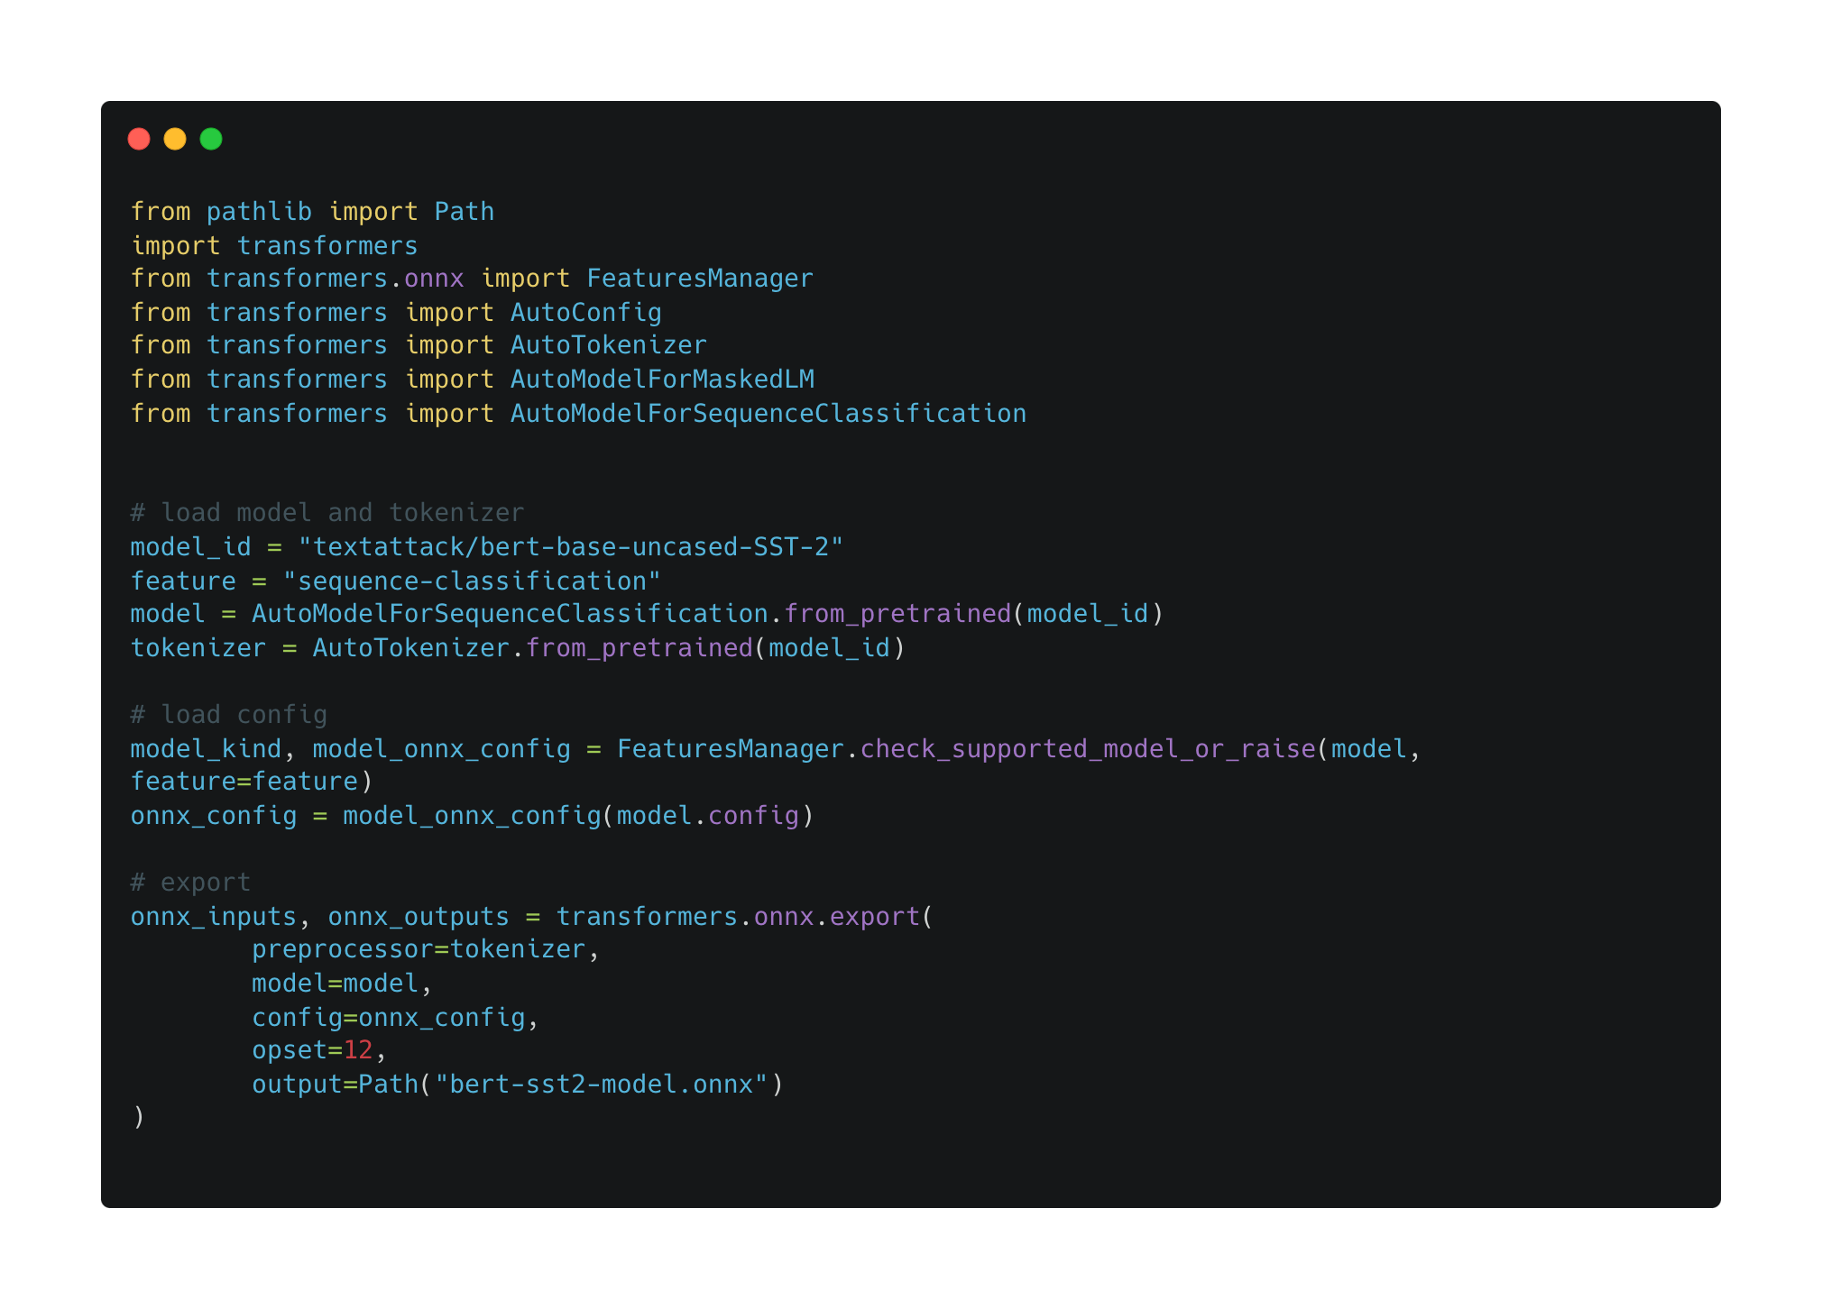
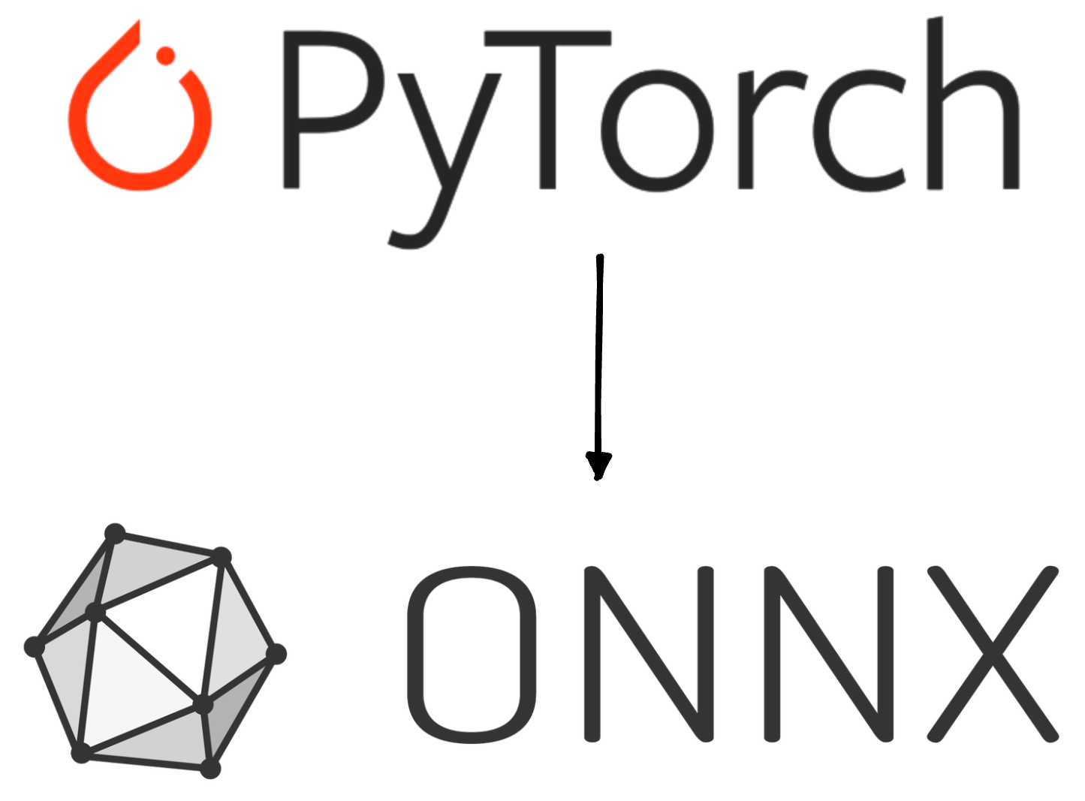
PyTorch to ONNX
Notes:
Using HuggingFace Transformers library, it’s quite easy to convert a PyTorch Model to ONNX.
Skip these code, say using few lines

Slide 23
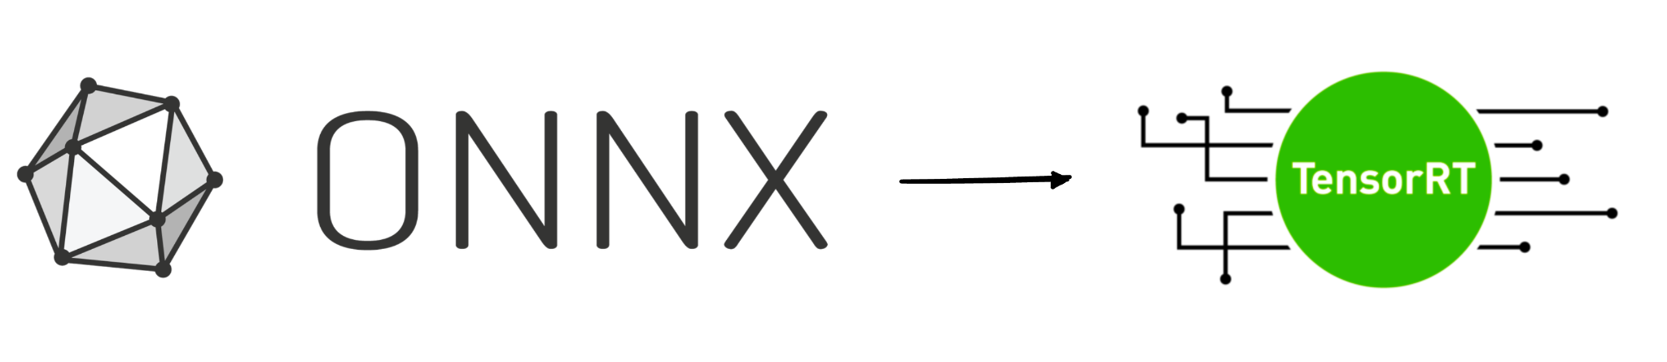
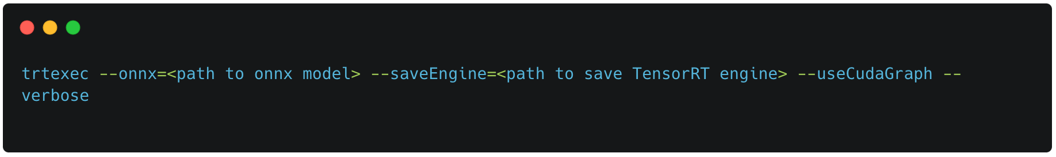
ONNX to TensorRT
Text and horizontal image
trtexec - a command-line tool for Onnx to TensorRT Engine conversion
PAGE NUMBER
Notes:
Skip the code, say few lines

Slide 24
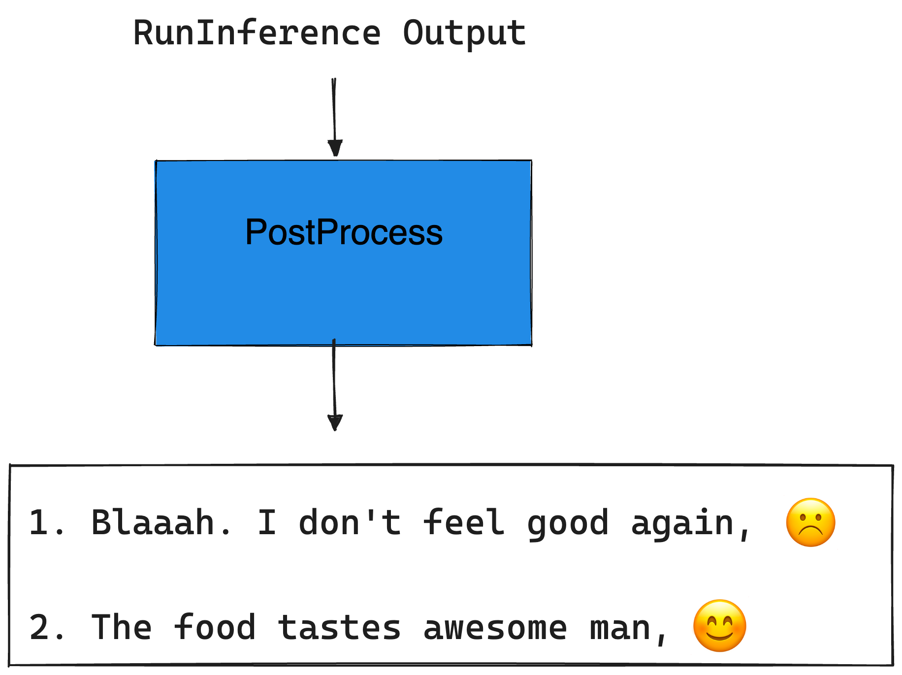
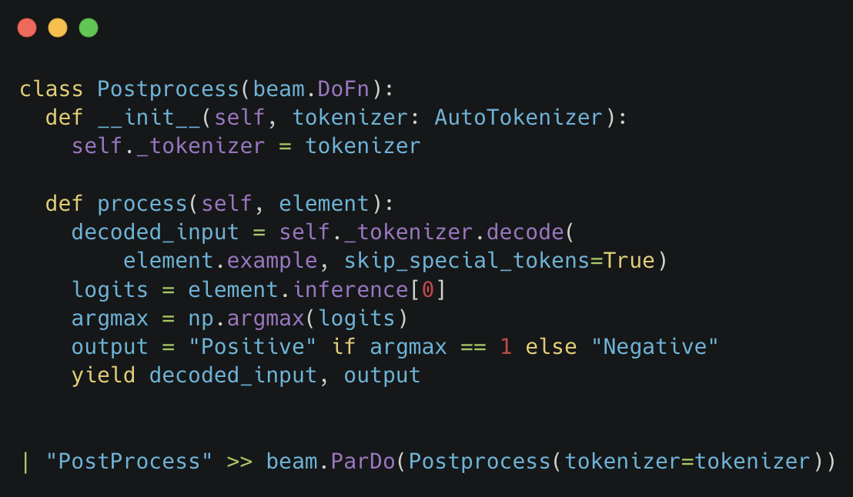
PostProcess RunInference Output
Notes:
Element.example was the input
Element.inference contains the prediction of the input
We take the argmax and

Slide 25
TensorRT is 4.1x faster than PyTorch
Model | Mean Inference batch Latency (in microseconds)
PyTorch | 15,176
TensorRT | 3,685
Mean Inference batch Latency: Average time to perform the inference on a batch of examples.
GPU: T4, Batch-size = 1 to mimic streaming setup
Notes:
Paint a bigger picture, here talk how large scale business can be affected by such small improvements.

Slide 26
Takeaways
RunInference transform eliminates the need for extensive boilerplate code in pipelines with machine learning models.
Beam and Nvidia TensorRT integration: Enhancing inference pipeline with improved GPU utilization, reduced production cost, and superior latency and throughput.
Notes:
Use large models like transformers, (LLMs)

Slide 27
Code and Tutorial Link
Code: GitHub Link
Tutorial: Apache Beam Documentation Link
Slides: GitHub Link

Slide 28


QUESTIONS?
Shubham Krishna
shubham-krishna-998922108
shub-kris

